Slide 1



thynk unlimited
Autonomous Agent Navigation in 2D Grid with Moving Obstacles
next slide

Slide 2


thynk unlimited
Problem Description
Objective:
Develop a simulation for an autonomous agent navigating a 2D grid.
Avoid both static and dynamic obstacles.
Combine traditional pathfinding algorithms with machine learning methods to optimize movement decisions.
Real-World Applications: Self-driving cars, Mobile robots, Autonomous drones
next slide

Slide 3
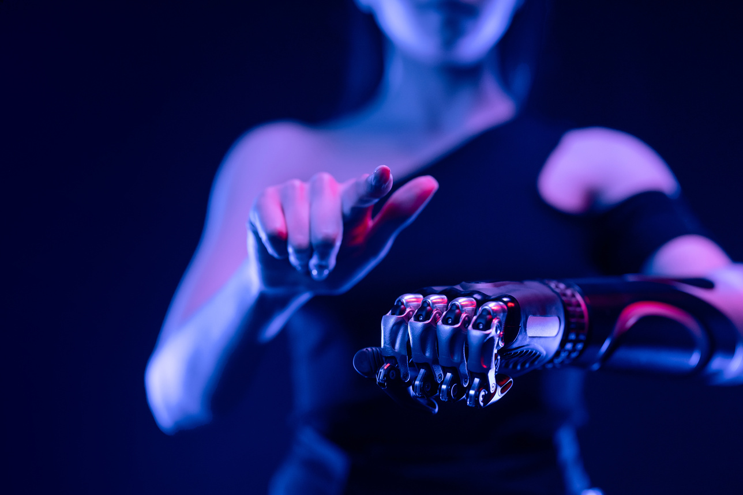
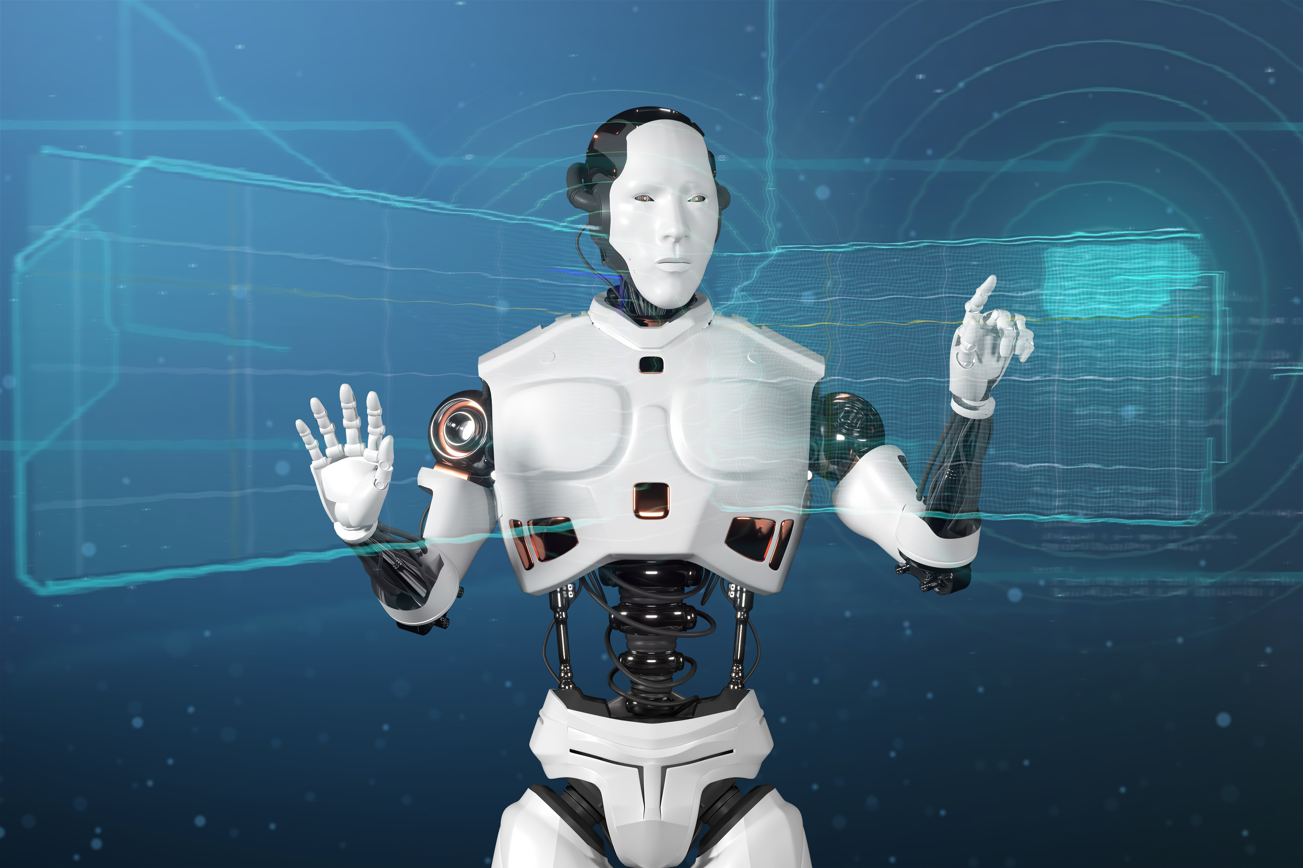
thynk unlimited
Input Data and Expected Output
Input Data:
· A 2D grid with discrete cells.
· Agent's starting and goal positions.
· Coordinates of static and moving obstacles.
Expected Output:
· An optimal trajectory ensuring safe navigation.
· Movement decisions for each timestep.
· Real-time visualization of the agent’s path within the dynamic environment.
next slide

Slide 4
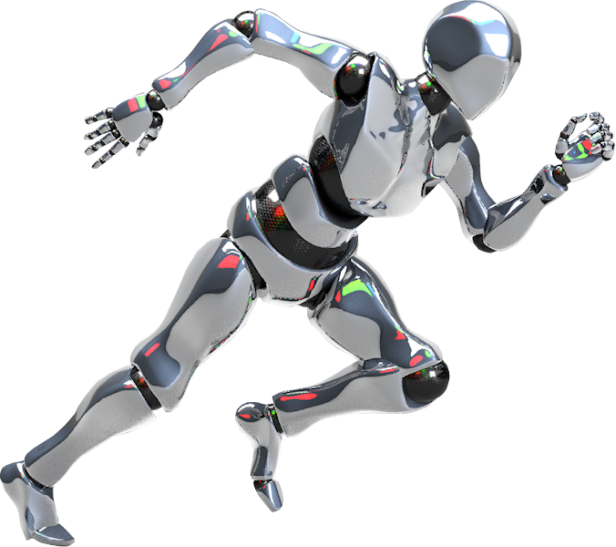
thynk unlimited
Dataset Overview
Dataset Structure: Each data sample records movement context:
Data is stored in CSV format for easy processing.
Dataset Generation Process:
· Randomly placing static and moving obstacles.
· Randomly selecting start and goal positions.
· Simulating expert behavior using Hybrid A* to
generate training samples.

Slide 5
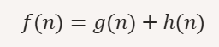
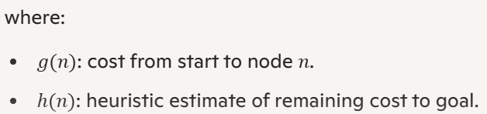
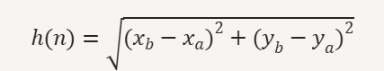
thynk unlimited
Pathfinding
Algorithm - Hybrid A*
Hybrid A* extends A* for continuous and dynamic environments. Formula for computing total path cost:
Using Euclidean Distance as heuristic:
next slide

Slide 6
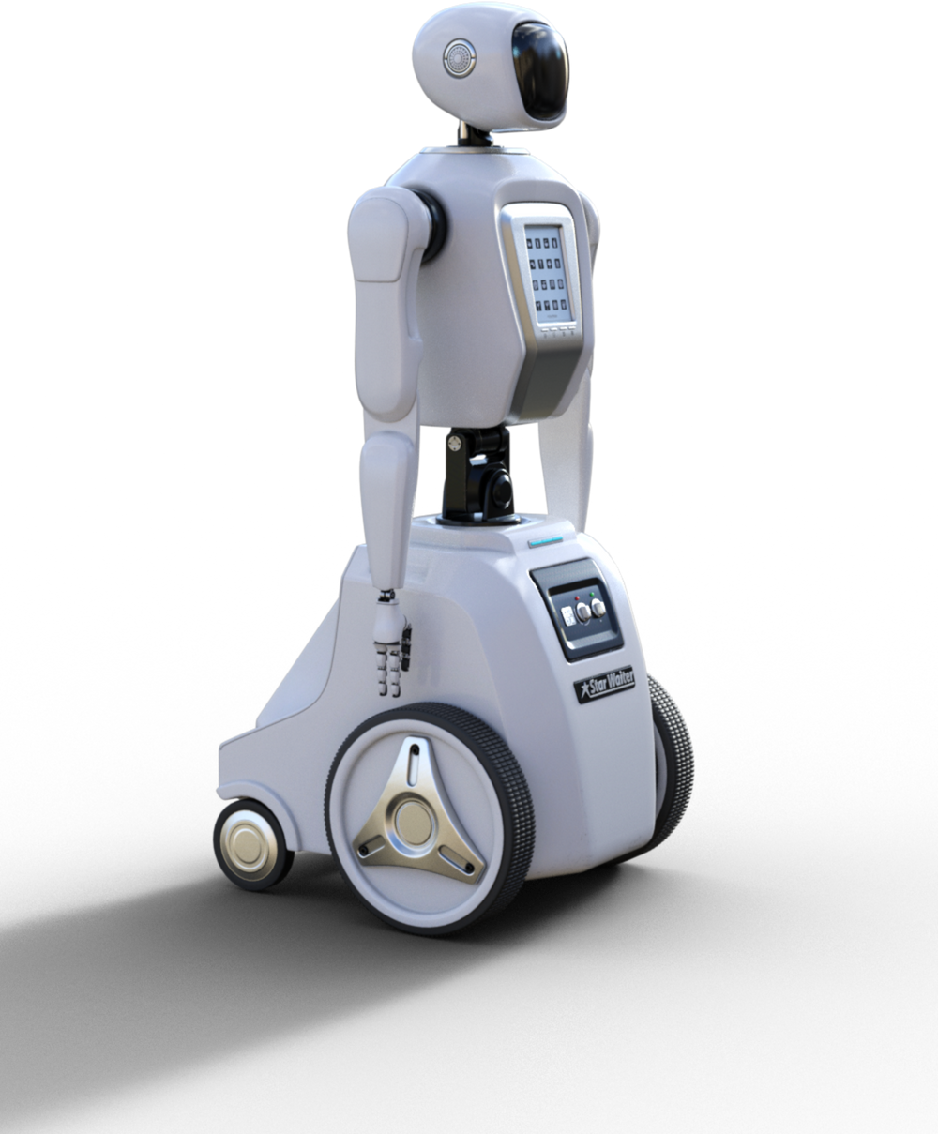
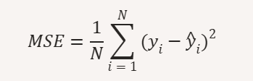
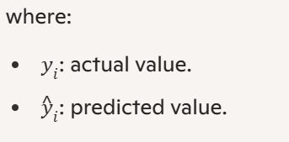
thynk unlimited
Machine Learning Model - Behavioral Cloning
Supervised Learning Approach:
Mimic expert navigation behavior.
Minimize the difference between predicted and actual expert actions.
Loss function using Mean Squared Error (MSE):
next slide

Slide 7

thynk unlimited
Model Improvement
with DAgger
next slide
Limitation of Behavioral Cloning:
If the agent encounters unfamiliar states → it is more likely to make errors.
DAgger’s Solution:
Continually expand training data with states the agent itself encounters.
Request expert corrections for mistakes.

Slide 8
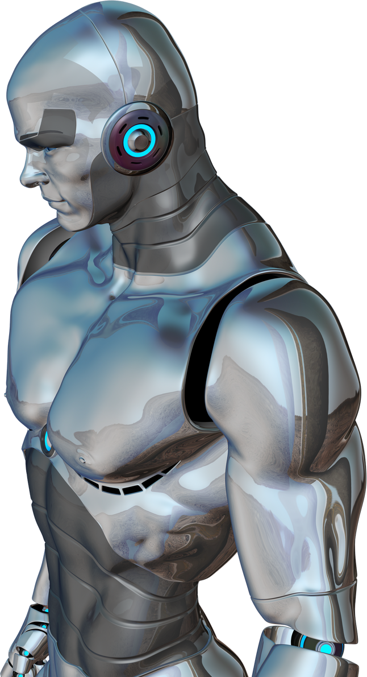
thynk unlimited
Combining Machine Learning and Pathfinding
Machine Learning: Predict next movement step based on data patterns.
Hybrid A*: Ensures optimal trajectory even with unpredictable obstacles.
Dynamic Replanning: The agent continuously updates its path based on new obstacle positions.
next slide

